Slide 1


An introduction to the work of Australia’s regulator of therapeutic goods
Therapeutic Goods Administration

Slide 2
Overview
Why do we need regulation?
Who is Australia’s regulator?
How the TGA operates
Who works at the TGA
Therapeutic goods
Australian Register of Therapeutic Goods
TGA’s mission
The benefit versus risk approach
Activities conducted before and after a product is released to the market
Australia New Zealand Therapeutic Products Agency
Other education modules

Slide 3
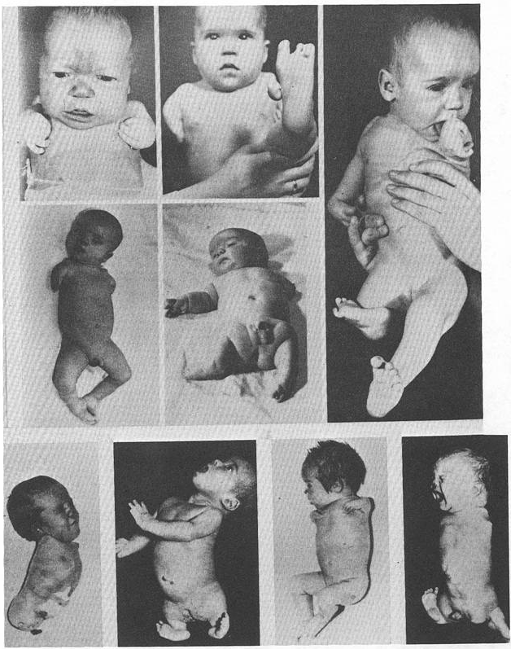
Why do we need regulation?
“In recent months I have observed that the incidence of multiple severe abnormalities in babies delivered of women who were given the drug thalidomide (‘Distival’) during pregnancy, as an anti-emetic or as a sedative, to be almost 20%.”
    Australian doctor William McBride alerted the world to the dangers of thalidomide in the 1960s which triggered the need for an Australian regulator of therapeutic goods.

Slide 4
Who is Australia’s regulator?
    The Therapeutic Goods Administration was established in 1990 to “safeguard and enhance the health of the Australian community through effective and timely regulation of therapeutic goods”
It provides a national system of controls
relating to the quality, safety, efficacy and
timely availability of therapeutic goods used
in, or exported from, Australia
Health
Safety
Regulation

Slide 5


TGA – how we operate
We are part of the Australian Government Department of Health
Every decision the TGA makes is based on the Therapeutic Goods Act 1989
Main offices in Canberra – satellite offices in Sydney, Melbourne, Adelaide and Brisbane
Operations are primarily cost recovered (98%) industry pays fees for making applications and annual charges for products they are responsible for

Slide 6
Who works at the TGA?
Approximately 750 staff made up of:
Biomedical scientists
Engineers
Physiotherapists
Medical officers
Pharmacists
Nurses
Toxicologists
Lawyers
Nutritionists
Dieticians
Scientists
Administrative staff

Slide 7


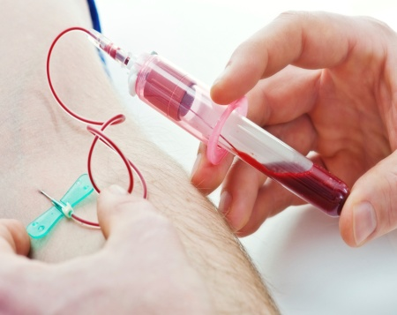

Under the Therapeutic Goods Act 1989, therapeutic goods are defined as:
Products for use in humans in connection with
preventing, diagnosing, curing or alleviating
a disease, ailment, defect or injury
influencing, inhibiting or modifying a
physiological process
testing the susceptibility of people to a
disease or ailment
influencing, controlling or preventing
conception
testing for pregnancy
replacing or modifying parts of the anatomy
All these products are therapeutic goods!

Slide 8
Types of therapeutic goods
Medicines and blood products
Medical devices
implants (artificial hips, breast implants)
in-vitro diagnostics (pregnancy tests, blood glucose monitors)
Biologicals
human stem cells
tissue-based products (skin and bone)
over the counter medicines
blood, blood components and plasma derivatives
cell-based products
complementary medicines
prescription medicines
low risk medical devices (bandages, tongue depressors, condoms)

Slide 9
Australian Register of Therapeutic Goods
All goods must be entered in the ARTG before they can be supplied in, imported to, or exported from Australia
Registered medicines
Listed medicines
Medical devices
higher risk medicines that are registered on the ARTG
evaluated for quality, safety and efficacy
Product Information is approved by the TGA
lower risk medicines that are listed on the ARTG
contain pre-approved, low risk ingredients
can only make limited claims and cannot imply that they will be useful in the treatment or prevention of serious illnesses
higher risk devices are evaluated for quality, safety and performance
lower risk devices are not evaluated for performance
Devices are classified according to their level of risk, ranging from Class I (lower risk) such as urine collection bottles to Class III (higher risk) such as antibiotic bone cements
All prescription medicines
Most over-the-counter medicines
Some complementary medicines
Some over-the-counter medicines
Most complementary medicines
9

Slide 10
TGA’s mission
To safeguard and enhance the health of the Australian community through the effective and timely regulation of therapeutic goods.
Health
Safety
Regulation

Slide 11
How do we fulfil this mission?
1
Good Manufacturing Practice or Manufacturing Principles: licensing Australian manufacturers and verifying compliance of overseas manufacturers (see the TGA education module on GMP)
2
Premarket assessments: assessing therapeutic goods for quality and safety (the extent of the assessment depends on the type of product and level of associated risk), and for higher risk products also for efficacy or performance
3
Postmarket assessments: monitoring of therapeutic goods and enforcement of standards (see the TGA education module on postmarket monitoring)

Slide 12
The benefit versus risk approach
No therapeutic good is risk free
The work of the TGA is based on applying scientific and clinical expertise to decision making
We ensure that the benefits outweigh any risks associated with the use of medicines, medical devices and other therapeutic goods

Slide 13
Premarket assessment
The level of assessment is based on how much risk the product poses
Low risk
High risk
  Products such as complementary medicines and low risk medical devices are assessed for quality and safety
  Products such as prescription medicines are assessed for quality, safety and efficacy
  High risk medical devices are assessed for quality, safety and performance
For both categories there are manufacturing standards that must be met

Slide 14
Postmarket activities
Monitoring/Alerts
Monitors claims made in advertisements for therapeutic goods and issues fines and sanctions if they can not be supported
Databases
Records reports of adverse events by consumers, health professionals and industry
Records recall actions
Issues alerts
Manufacturing
Further inspections of manufacturers of therapeutic goods

Slide 15
Australia New Zealand Therapeutic Products Agency
The Australian and New Zealand Governments have agreed to proceed with a joint scheme for regulation of therapeutic goods by 2016
The creation of a joint regulatory scheme across both countries will safeguard public health and safety, while encouraging economic integration and benefitting industry in both countries
The Australia New Zealand Therapeutic Products Agency will absorb the current regulators; Australia’s Therapeutic Goods Administration and New Zealand’s Medsafe
Medsafe
TGA
ANZTPA

Slide 16
Other education modules include:
Medicines
Biologicals
Medical devices
Postmarket monitoring
Good Manufacturing Practice

